Slide 1
WEATHER PREDICTION dataset
CS 579 – final project – progress presentation
Yang, Tzu - Hua
Vignesh J Muralidharan
Abhinav Prabhu Adarapuram
Fadhil Salih

Slide 2
overview
Introduction
Data description
Data visualization
Metadata – original
Pre processing
Metadata – recorded after preprocessing
Data management
Analysis – machine learning – methods planed
conclusion

Slide 3
introduction
Data collection: Data gathered from weather underground website – for 5 major cities in world for the year 2016 – 2017
Each city weather conditions are collected for all year (365 days)
This data was chosen in a way to understand the weather condition in cities
Aim: develop approaches for predicting whether the events happening is a (normal sunny) day or (rain/hail/snow/thunderstorm) and predicting for year 2018 on the basis of considering available training data.

Slide 4
Data description
DIMENTION OF THE DATA ⬄ 3655 ® & 25 ©
City name
date
year
month
day
Temperature – High, average, low
Dew point – high, Average, Low
Humidity – high, average, low
Sea level – high, average , low
Visibility – high, average, low
Wind – high, average, low
Precipitation for the day
Event – rain/snow/hail/thunderstorms
Dataset includes,
2217 “NA’s” in the response variable
Several “NA’s” in the variable in low wind
Several “0” in the precipitation variable

Slide 5
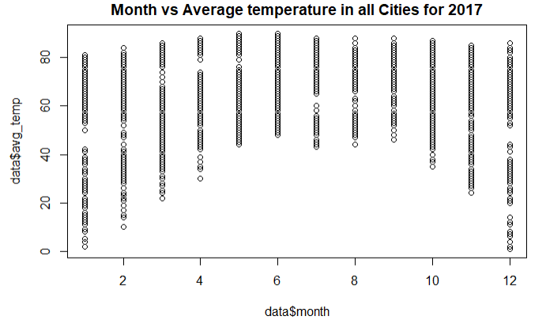
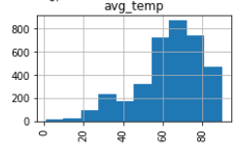
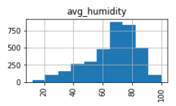
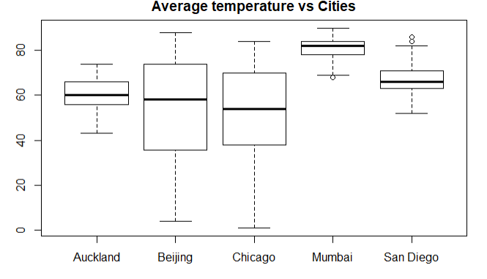
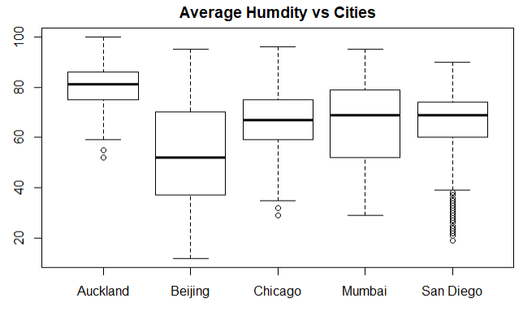
Data visualization

Slide 6
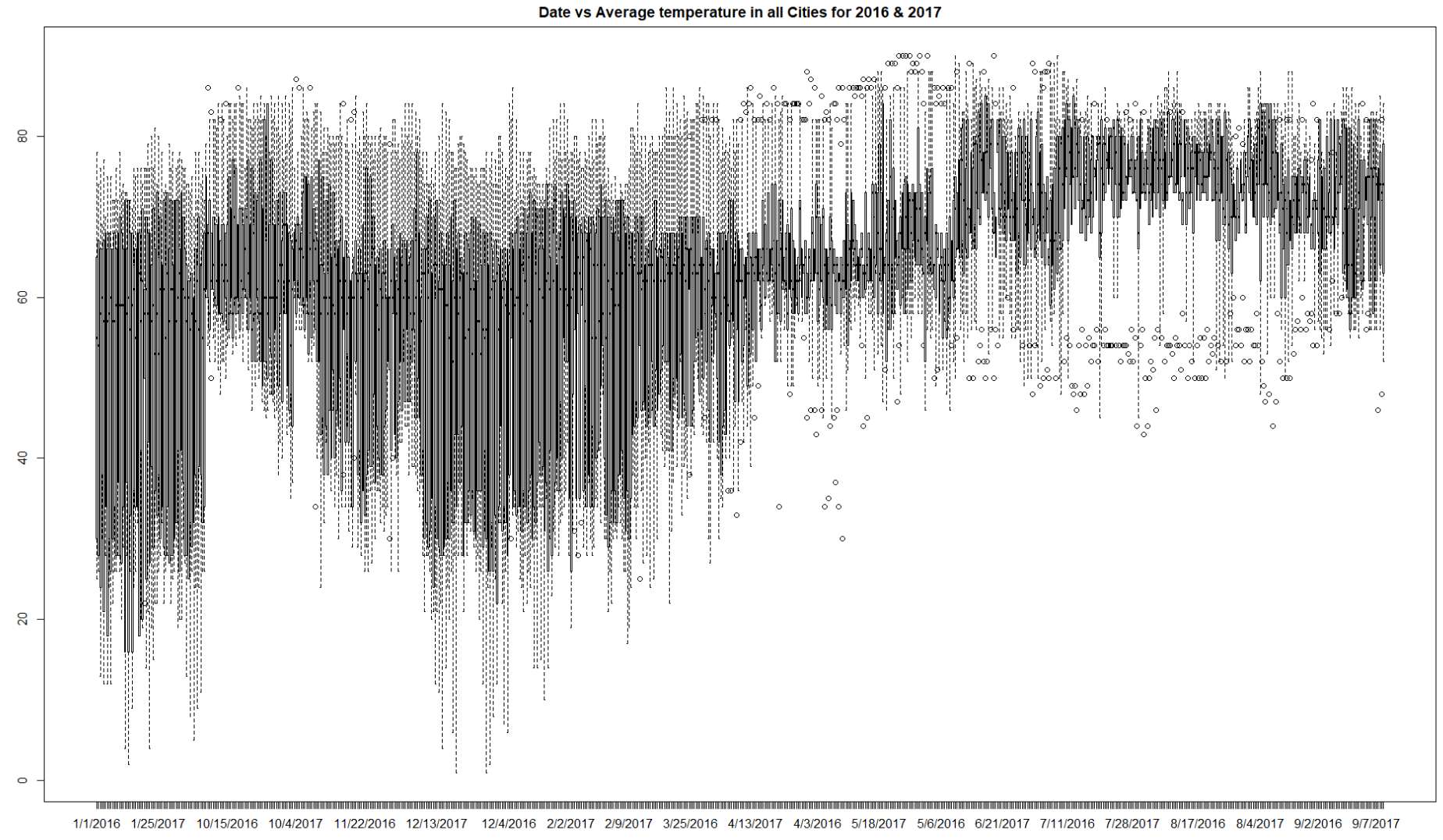

Slide 7
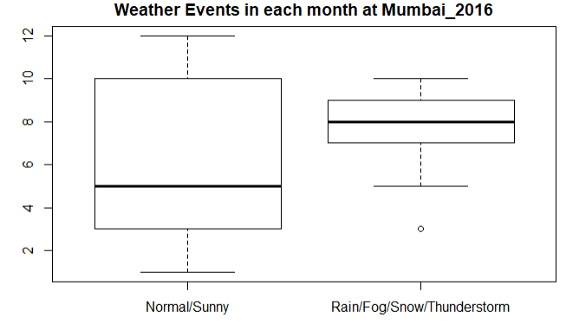
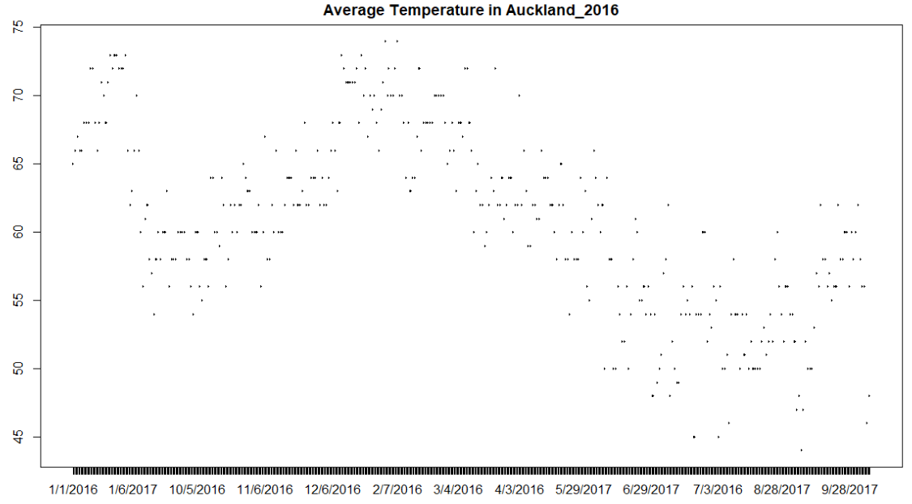
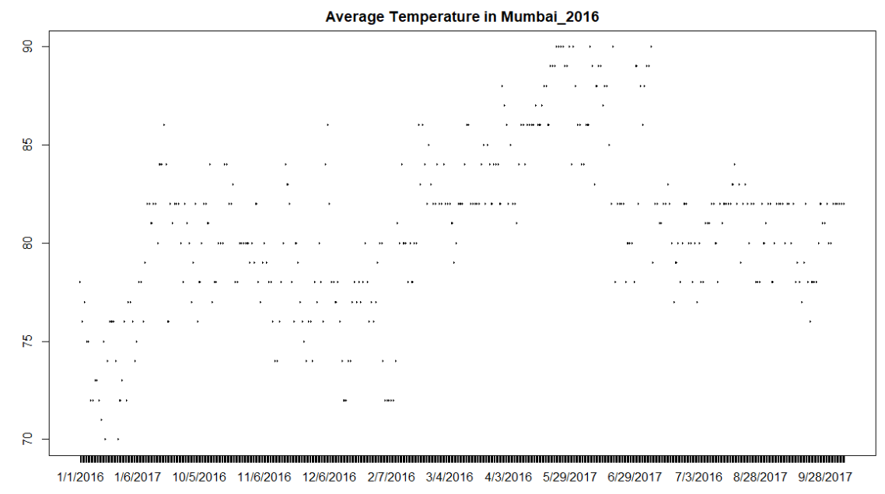

Slide 8
Metadata – original dataset (Dublin Core)
Digital Object Identifier (DOI) Number: The data was not published
Title / DOI Related Article: Evidence of weather conditions for different cities for the year 2016 - 2017
Variable info link: https://vincentarelbundock.github.io/Rdatasets/doc/mosaicData/Weather.html
Creator: The creator was not available
Publisher: Not published yet
Date Published: not given | Date Downloaded in computer: 17th Mar 2019
Source: Dataset https://vincentarelbundock.github.io/Rdatasets/datasets.html?fbclid=IwAR1a_0LfN4gf5mQjCyOacu3ucqQ1jZvlu7Tz1pd5atiLtslBQhc9QSCKyFE
Type: Metadata (.doc or .pdf), Dataset (.Xlsx, .CSV, .PPT)
Language: English
Dimension of the actual dataset: 3655 (Observations) & 25 (Variables)
List of Textual Variables: City – Total 1
List of Continuous variables: Total 20
List of categorical variables: Target (Y) Events – Total 1
List of Time series variables: Year, Month, Day – Total 3
Target: Variable Name – Events => Rainy/Fog/Thunderstorms/Snow/sunny/normal – 6 levels
Relation: Graduate student coursework project work for CS 579 - UIDAHO

Slide 9
preprocessing
STARTING WITH “NA’s” IT HAS BEEN REVALUED TO “0” except for the target variable
Response “events” had 2217 na’s
Logical organization, instead of having 12 levels we are converting into 2 levels
Not everyday the city will have rain or snow or thunderstorms and hail
Converted the available observations to only level just “rain/snow/hail/thunderstorms”
Converted the “na’s” to “normal/sunny” days
DIMENTION OF THE DATA after preprocessing ⬄ 3655 ® & 24 ©

Slide 10
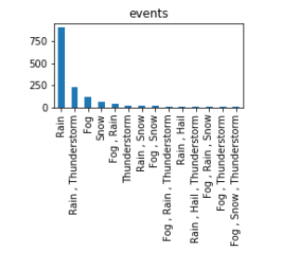
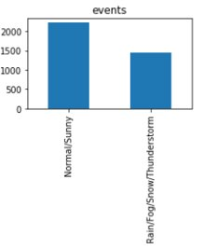
response
BEFORE
AFTER

Slide 11
Metadata – after preprocessing
Digital Object Identifier (DOI) Number: The data was not published
Title / DOI Related Article: Evidence of weather conditions for different cities for the year 2016 - 2017
link: https://vincentarelbundock.github.io/Rdatasets/doc/mosaicData/Weather.html
Creator: The creator was not available
Publisher: Not published yet
Date Published: not given| Date Downloaded in computer: 28th Mar 2019
Source: Dataset <https://vincentarelbundock.github.io/Rdatasets/datasets.html?fbclid=IwAR1a_0LfN4gf5mQjCyOacu3ucqQ1jZvlu7Tz1pd5atiLtslBQhc9QSCKyFE
Type: Metadata (.doc or .pdf), Dataset (.Xlsx, .CSV, .PPT)
Language: English
Dimension of the actual dataset: 3655 (Observations) & 24 (Variables)
List of removed variables: SNO, date , low wind (because of more NA’s)
List of Textual Variables: City – Total 1
List of Continuous variables: Total 18
List of categorical variables: Target (Y) Events – Total 1
List of Time series variables: Year, Month, Day – Total 3
Target: Variable Name – Events => Binary (0 – Rainy/Fog/Thunderstorms/Snow, 1 – Normal/Sunny days)

Slide 12
Data management
Creation of logical collections: We analyzed required logical understandings and transformed using R and Excel by visualizing different attributes
Physical Data Handling: We have backed up data each time when we updated, imputed or transformed the data into one drive and Github as .CSV document.
Interoperability support: We made sure data could be downloaded as .CSV format and we all have access through cloud which will help and use in different platforms like R, Python, JAVA.
Data ownership: This data is not published by the data creator. So all members of the team will be reviewing any edited aspects to ensure the actual needs. The ownership is not planned to share until the study is analyzed and published
Security Support: Metadata is stored in Main project directory.
All team members + Project watching member have access to one drive
All edits made by members can be viewed by all 5 people

Slide 13
Data management (cont..)
Management & Access: Metadata is included (Dublin Core standard) as .DOC file in main directory of one drive project
Persistence: Data updated as per March 28th 2019, Old and future records will be updated as and when needed in one drive
Discovery: The link of the data before preprocessing is provided in Metadata. Once published the link will be provided for public
Data Dissemination and publications: Edited versions of data has been stored to compare the original dataset. As of now we are using
Data Visualization ( R, Excel, Python )
Imputation & data frame editing ( R & Python )
Analysis ( R, Python, JAVA)
Changes will be recorded in metadata and shown if class students or professor is interested

Slide 14
MACHINE LEARNING
Goal: To perform classification on the selected dataset (Weather) to demonstrate supervised learning methods under machine learning
Target Variable (Binary): Event => (Rain/No Rain) / (0/1)
Logistic regression model will be used to predict the event among the major cities given in the dataset
Since the target variable is binary, logistic regression is selected
Expected results: Accuracy of the model, ROC curve, Area under ROC curve

Slide 15
Machine learning method
Goal – To predict the event of weather
Methods –
Multi-Layer Perceptron
Time Series – Annual Average Temperature, Annual Average Humidity
Training
(Supervised Learning)
Model 1
Training
(Supervised Learning)
Model2
(Predicted) Temperature
Temperature
Humidity (Predicted)Dew … …
Time Series
Model 1
Model2
(Predicted) Event
(Predicted)
Humidity

Slide 16
CONCLUSION
Metadata has been created
Data cleaning / Preprocessing has been carried in needed areas of dataset and updated
Updated metadata with all new editions
Initial Data management policies has been carried out and continued for future analysis
Machine learning methods has been finalized and ready to implement

Slide 17
FUTURE WORK
DATA ANALYSIS

Slide 18
THANK YOU

